Slide 1
Function Pointers & DLLS
Outline how ordinary pointers are used
Explain the use of function pointers
Use function pointers in programs
Explain how Run-Time DLLS work
Compare Run-Time & Load-Time DLLs
Software Engineering Practices

Slide 2
Pointers
*ptrInt is exactly the same as intVar
In general, *Xptr is the variable that Xptr is pointing to
int *
Used to declare a pointer to an int
Simple strings are represented by a null terminated array of character
(mark the end with zero)
&intVar
Is the address of the intVar variable
Pointer variables store addresses
  memory locations.
Declaring pointers
int * ptrInt; //declaration
int intVar =10; //initialisation
char * name = “hi”; //point to start
ptrInt = &intVar; //assign address
cout << * ptrInt; //dereferencing
ptrInt
100
104
90
91
92
intVar
104
10
name
108
90
‘h’
‘i’
0

Slide 3
Pointers to Functions
Function machine code is held in memory
  Pointer is address of first instruction
Function name on its own is the address
  int x2(int a){
  return 2*a;
  }
  x2(5) is 10
  x2 is the address of the function x2

Slide 4
Function Pointer Syntax
int *x;
As *x is an int, x is a pointer to an int.
void (*foo)(int);
foo is a pointer to a function with one int parameter, returning nothing.
As *foo is a function taking int returning void, foo is a function pointer
Like declaring a normal function using (*functionName), not functionName
  Need brackets to bind * to foo, not to void
What is int *foo(int)?

Slide 5
Function Pointers
A function pointer variable can point to only one sort of function
  Defined by return type & types of parameter
  Points to functions with the same signature
What type are the following variables?
  int * pInt;
  int (*pFa)(int, int)
  void (*pFb)(double)
  int *fc (int, int)
() attaches the * to the function name
Spot the difference
pFb
can point to any function taking a double and returning nothing
pFa
Can point to any function with 2 integer parameters returning int
pInt
can point to an integer
fc
is a function taking 2 ints & returning a pointer to an int

Slide 6
Using Function Pointers
void my_int_fun(int x) {
cout << x << endl;
}
int main() {
void (*foo)(int); // declare function pointer
…
foo = &my_int_fun; // & is optional
… // my_int_fun is the same
foo(99);
}

Slide 7
Using typedef for neatness
typedef defines new types
typedef int (*FPointer)(int, int);
int caller (FPointer func, int p) {
return func(p, p);
}
FPointer is now a type
  Can be used like int, char, etc.
  Less chance of mistyping long definition
FPointer is a new type: use to declare variables
FPointer funcP;
Which function can funcP point to?
void f1(int a, int b);
void f2(int a);
int f3(int a, int b);
int f4(int a);
FPointer f5(int a, int b);
FPointer f6(int a);

Slide 8
Load-Time vs. Run-Time DLLs
Load-Time DLL
  Loaded when using program is loaded
  Links to functions made before program runs
Run-Time DLL
  Loaded when requested by the program
  Links to function requested by the program
    Refer to functions by name or number
  Uses function pointers
The program is different not the DLL

Slide 9
Run-Time Dynamic Linking
Library1.dll
1. Program is loaded. No DLL loaded.
Library2.dll
Library3.dll
3. Library2.dll is loaded by Windows
Program.exe
Program
2. Program decides to load Library2.dll.
Asks OS to load it
Library2.dll
Load Library
Get procedure address
Use function
Free Library
4. Program gets a function pointer and calls the function
Function

Slide 10
Run-Time Linking Advantages
Program is in control
  Can decide whether to end if DLL absent
  Can carry on with reduced functionality
Delay loading DLL until functions needed
  Don’t load DLL if it’s not needed
Choose from several DLLs based on input
Can reduce the memory required
  Load / unload DLLs
Can load several plug-ins
  Each held in DLL
    Functions with same signature / different effects

Slide 11
Run-time linking: disadvantages
Delays at run-time
  More noticeable than delay at load-time
Slightly less efficient function call
  Load address from pointer, then call it
Program will run even if DLL is missing
  Can allow program to fail gracefully
  But may not be desirable if DLL is essential
More work in programming

Slide 12
Run-Time Dynamic Linking
Run-time dynamic linking Windows API
HMODULE LoadLibrary(LPCSTR filename)
  Ask the OS to load the DLL.
GetProcAddress(HMODULE h, LPCSTR fn)
  Find address of a function in the DLL
FreeLibrary(HMODULE h)
  Detach from the DLL
  The OS keeps a count of using programs
    If no other program is using the DLL, it will be deleted from memory.

Slide 13
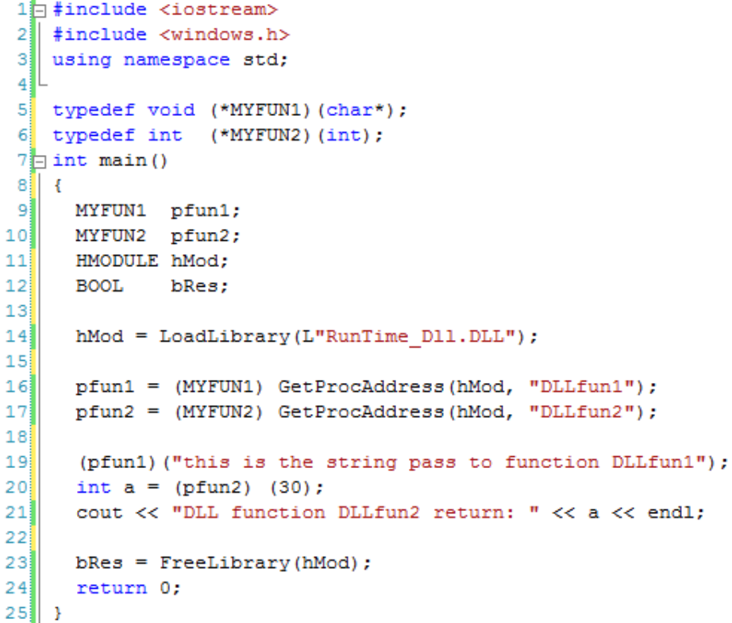
Using Dynamic Linking
HMODULE LoadLibrary(filename)
  Load the dll
GetProcAddress(HMODULE, funName)
  Get function address
FreeLibrary(HMODULE)
  Release library
typedef to simplify declaration of function pointer
Obtain a function pointer.
Note the cast
NULL returned if there is an error
Create function pointers ready to point to functions obtained from the dll
Release the library.
The OS may unload it if no-one else is using it
The library is loaded into memory.
An error value will be returned if there is a problem.
Use the function pointer.

Slide 14
Libraries
Name 2 types of libraries
Explain the operation of each type
Compare the 3 ways of using libraries

Slide 15
DLL Traps: Unicode
WideChar / Unicode
  Represents characters with 16 bits
  Allows a wider range of characters: ЛЊЌ
  LoadLibraryW() expects Unicode name
    L"cryptLibrary" not "cryptLibrary"
Multi-byte
  Represents characters with 8 bits
  LoadLibraryA() expects normal string
Use preprocessor directive _UNICODE
  To allow different versions to be generated

Slide 16
DLL Traps: Unicode
What does the following do?
#ifdef _UNICODE
#define LoadLibrary LoadLibraryW
#else
#define LoadLibrary LoadLibraryA
#endif

Slide 17
DLL Traps: name mangling
C++ encodes parameter types in the function name output to the object files
GetProcAddress won't find the real name
Turn name mangling off for DLLs:
extern "C" { // like C - no mangling
void setKey(int key);
} // end extern "C"

Slide 18
Using the Preprocessor
What does the following do?
#ifdef __cplusplus
extern "C" {
#endif
void setKey(int key);
#ifdef __cplusplus
} // end extern "C"
#endif

Slide 19
DLL Traps
LoadLibrary
  Has to be able to find the DLL
    Looks in folder the program came from
    Then various system folders
  Don't forget to test the return value
GetProcAddress
  You will need to cast the result
  typedef int (__cdecl *Ftype)(LPWSTR);
  theFun = (Ftype)GetProcAddress(hLib, "myfun");
FreeLibrary
  Don't forget to call it

Slide 20
Function Pointer Example
// Four arithmetic operations ...
int Plus (int a, int b) { return a+b; }
int Minus (int a, int b) { return a-b; }
int Multiply (int a, int b) { return a*b; }
int Divide (int a, int b) { return a/b; }
// Function with a function parameter
void Call_FP ( int a, int b, int (*pF)(int, int))
{
cout << pF(a, b) << endl;
}
int main(int c, char* v[])
{
Call_FP(2, 5, Minus);
}
pF is the function pointer
A function pointer points to functions with a specific signature. They have the same types of parameters & return type
Using the function pointer to call the function passed as a parameter.
Passing a function as a parameter to another function

Slide 21
Function Pointer as parameter
int myFunc (int a, int b) {
return a + b
}
int caller (int (*func)(int, int), int p) {
return func(p, p);
}
int main(void){
cout << caller ( myFunc, 10);
return 0;
}
typedef int (*PFunType)(int, int);
int caller (PFunType func, int p) {
return func(p, p);
}

Slide 22
Useful Function Pointers 1
Assume we have arrays of people objects
  Each entry stores name, age, salary, …
Function to sort by name is inflexible
Add parameter for ascending/descending
  Still inflexible
    Couldn’t handle new sorting criteria
    E.g. by age or salary, or by salary then by age
SortByName(myPeople, true)
Would need different functions for sorting by different criteria
Sort (myPeople, compareFP)
Pass different functions to sort by different critera
fred
dave
jane
pat
SortByName(myPeople)
Would need different functions for sorting into ascending or descending order
jo
hilary
24
24
20
31
19
26
23000
25000
26000
31000
2500
26000
PR1 2HE
PR1 2HE
PR1 2HE
PR1 2HE
PR1 2HE
PR1 2HE

Slide 23
Useful Function Pointers 1
Pass comparison function as parameter
  This function might take two people and return true/false based on some criteria.
  Much more flexible
    User can sort by any criteria
    No need to change the sort function
bool byNameA(Person p1, p2){
return p1.name>p2.name;
}
bool byNameD(Person p1, p2){
return p1.name<p2.name;
}
bool byNameAge(Person p1, p2){
if (p1.name == p2.name)
return p1.age > p2.age;
else
return p1.name > p2.name;
}

Slide 24
Using Function Pointers: qsort
qsort – a common system routine
  Flexible criteria with function pointer
  void qsort(
  void *base,
  size_t nElem,
  size_t sizeElem,
  int(*comp)(const void *, const void *)
  );
Pointer to start of array
Number of elements
Size of each individual element
Pointer to a function that
Takes 2 elements
Returns -1 first<second,
0 equal,
1 first>second
A very flexible routine.
Can handle any type of data & any criteria

Slide 25
Using qsort
int intComp ( const void *p1, const void *p2 ) {
int first = * (int*) p1;
int second = * (int*) p2;
if ( first < second ) return -1;
else if ( first == second ) return 0;
else return 1;
}
int main() {
int array[10];
for (int i = 0; i<10; ++i) array[i]=10-i;
qsort(array,10, sizeof(int), intComp );
for (int i=0;i<10;++i){cout<<array[i];}
}
A cast: tells the compiler that p1 is pointing to an integer:
(int *) p1
Then get the value it is pointing to
* (int *) p1
Easier to store in temporary variables than to use *(int *) p1 everywhere

Slide 26
Useful Function Pointers 2
Callback Functions
  Functions called when an event occurs
    “listener” function given to a server routine that is doing something for you
    Listener called when server completes
Examples
  Opening a file
  Setting up a communication link
  Sending a packet of data
  Notification when a button is pressed

Slide 27
Using Callback Functions
Sending a block of data
  Want to be notified on completion
Possible function header
void send( char *data, void (* callback)() );
Possible use
void notify(){
cout << "block sent" << endl;
}
…
send(myDataPointer, notify);
Send the data.
When it has gone, call notify()

Slide 28
Function Pointer as Result
typedef int (*pt2Func)(int, int);
int Plus(int a, int b) { return a+b; }
int Minus(int a, int b) { return a-b; }
pt2Func GetFunPtr(const char opCode) {
if(opCode == '+')
return Plus;
else
return Minus;
}
int main() {
pt2Func myFunPtr = GetFunPtr('-');
cout << myFunPtr(2, 4) << endl;
return 0;
}
The result of a function can be a function pointer.
This is essential for run-time loaded dlls
The result is one or other of the functions

Slide 29
Summary
Function Pointers
  Useful in their own right
  Essential for Run-time DLLS
Run-Time DLLs
  Library loaded explicitly by program
  Program requests pointer to function
  Program uses functions
  Program unloads library
Run-Time vs. Load-Time DLLs

